Slide 1
WIFI LOCATIONING
Gerhard Westerbeek
Data Analyst at IOT ANALYTICS

Slide 2
Business Question
Feasibility of using "wifi fingerprinting" to determine a person's location in indoor spaces.
Evaluate multiple machine learning models to see which produces the best result, enabling us to make a recommendation to the client.
If recommended model is sufficiently accurate, it will be incorporated into a smartphone app for indoor locationing.

Slide 3
DataSET
In total 21049 sampled points have been captured;
- 19938 for training/learning
- 1111 for validation/testing.
The number of different places (reference points) appearing in the database is 933.
It can be used for classification, e.g. actual building and floor identification, or regression, e.g. actual longitude and latitude estimation.
Each WiFi fingerprint can be characterized by the detected Wireless Access Points (WAPs) and the corresponding Received Signal Strength Intensity (RSSI). The intensity values are represented as negative integer values ranging -104dBm (extremely poor signal) to 0dbM. The positive value 100 is used to denote when a WAP was not detected.

Slide 4
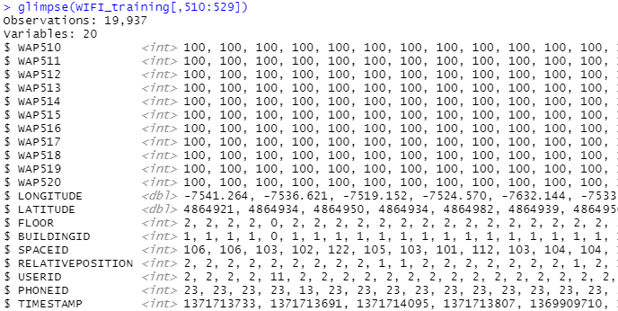
IMPORT THE DATA
Dataset contains “integer vectors” and “double vectors. No missing values detected.

Slide 5
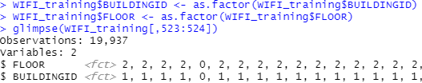
Data wrangling: transforming to factor

Slide 6
Data wrangling: Create attribute of sum of WAPS detected (VALUE != 100)

Slide 7
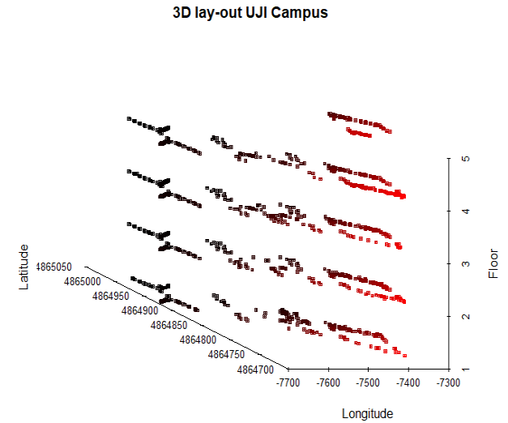
DATA EXPLORATION: 3D lay-out campus

Slide 8
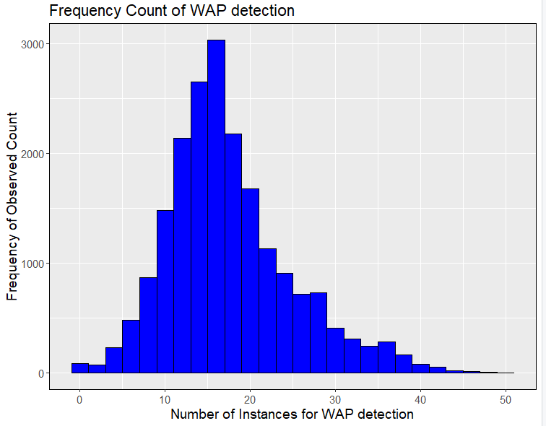
DATA EXPLORATION: Histogram WAP detection

Slide 9
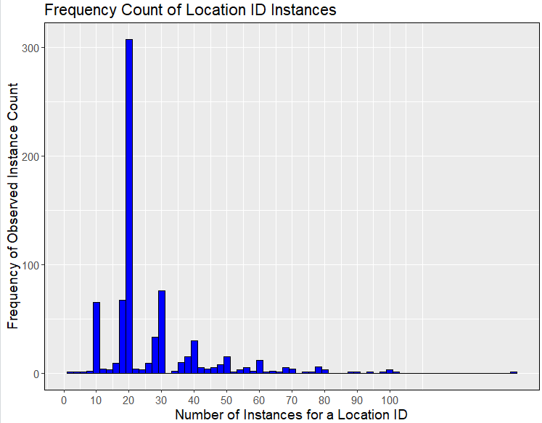
DATA EXPLORATION: histogram frequency count location ID

Slide 10
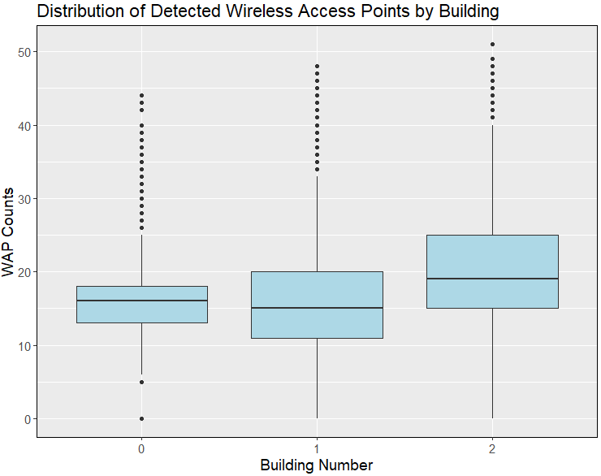
DATA EXPLORATION: Distribution of WAP count by building- boxplot

Slide 11
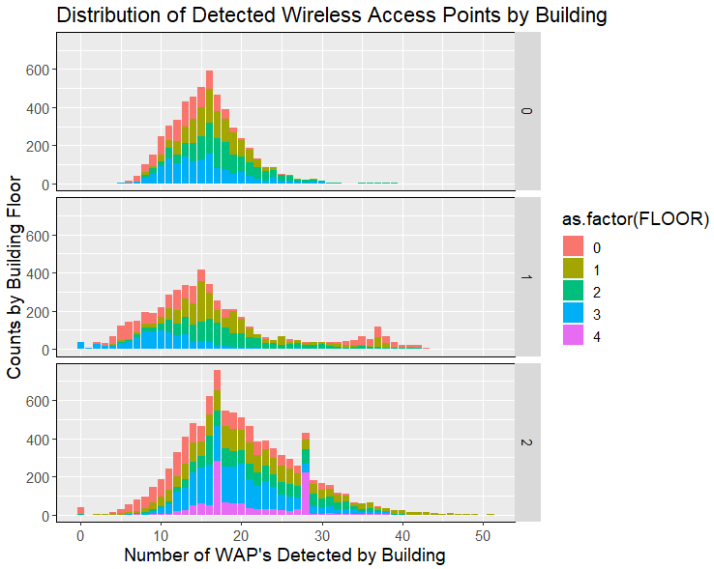
DATA EXPLORATION: Distribution detected WAP’S BY BUILDING

Slide 12
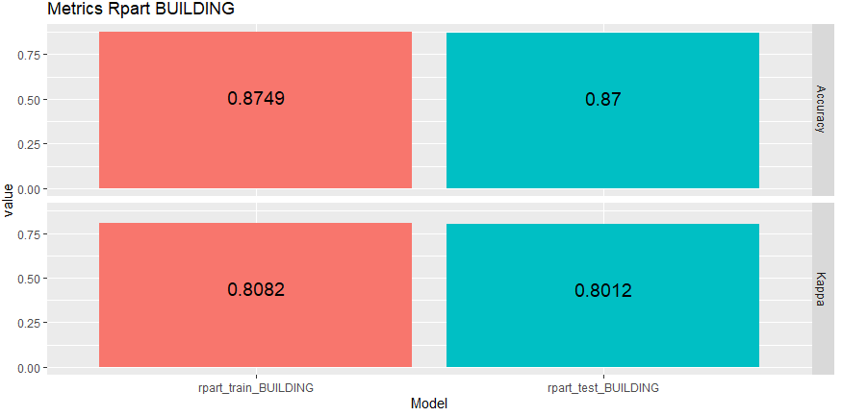
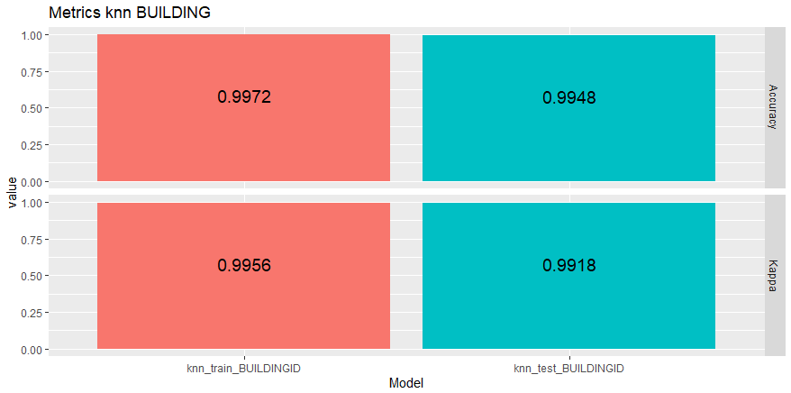
1st Error check models rpart and knn BUILDING
RPART | KNN

Slide 13
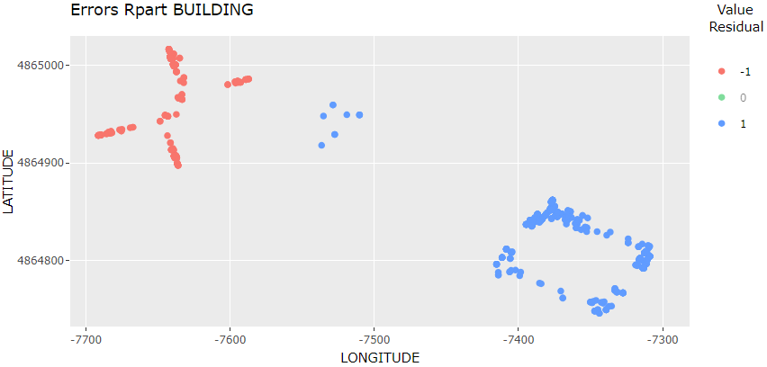
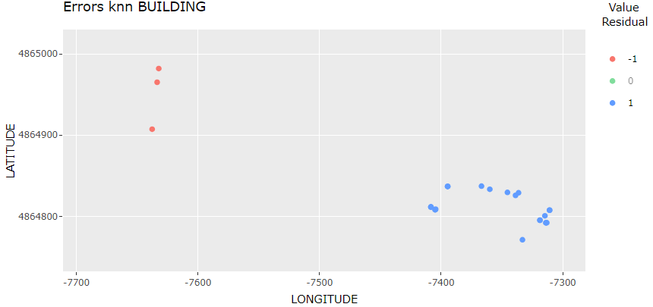
2nd Error check models rpart and knn building
RPART | KNN

Slide 14
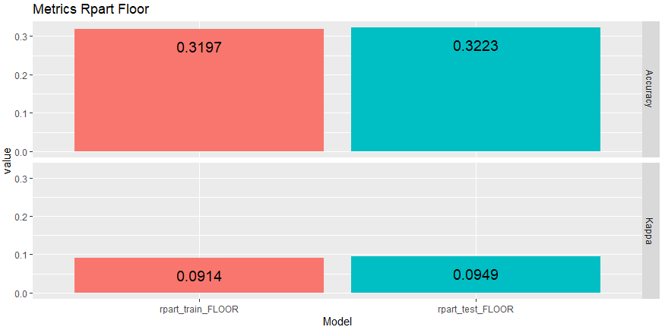
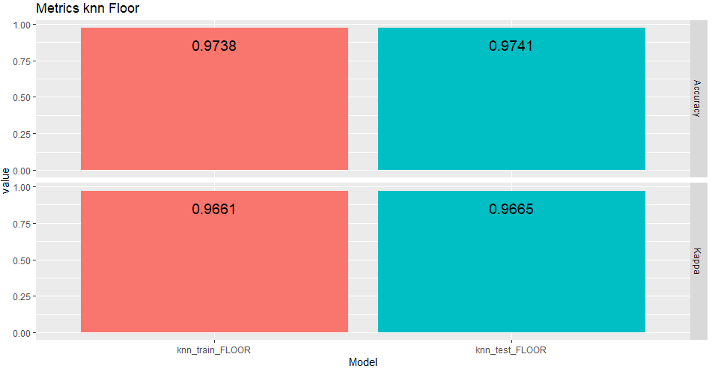
1st Error check models lm and knn floor
RPART | KNN

Slide 15
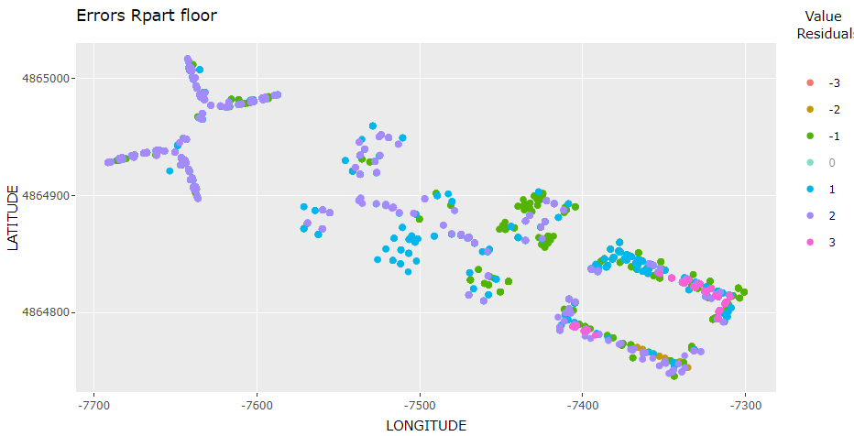
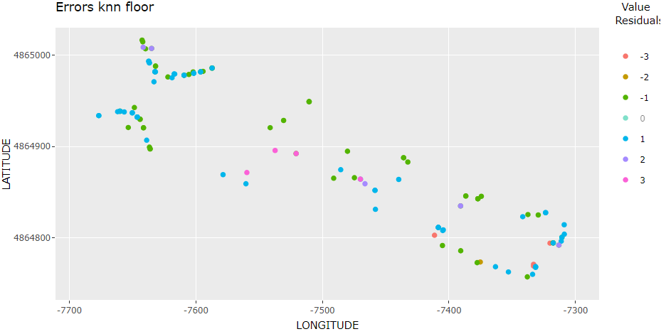
2nd Error check models lm and knn floor
RPART | KNN

Slide 16
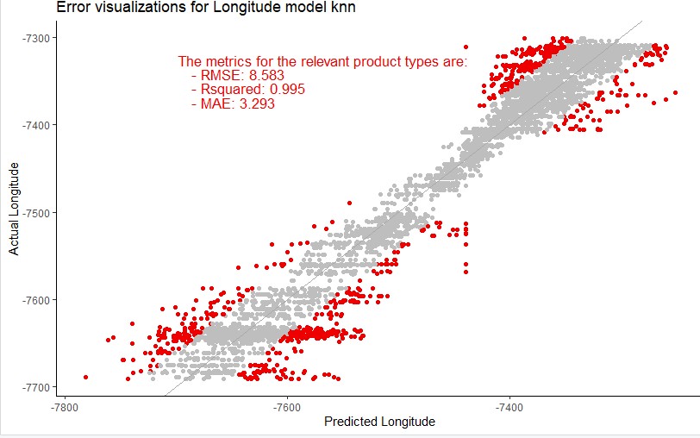
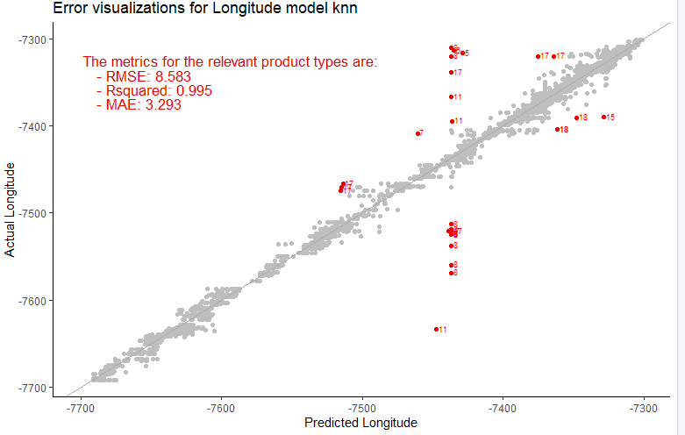
2nd Error check models lm and knn longitude
LM | KNN

Slide 17
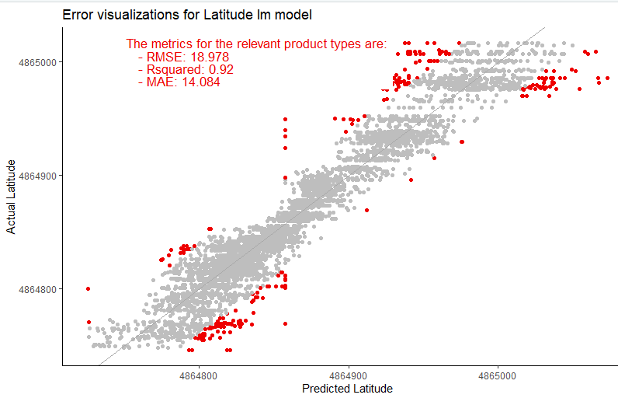
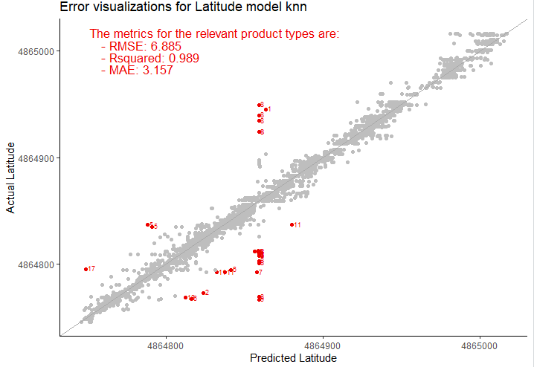
1st Error check models lm and knn latitude
LM | KNN

Slide 18
PreProcess steps KNN model
Change RSSI value +100dBm to -120dBm
Detect and remove duplicate rows in dataset
Run models on validation dataset
Visualise results for BUILDING, FLOOR, LONGITUDE and LATITUDE

Slide 19
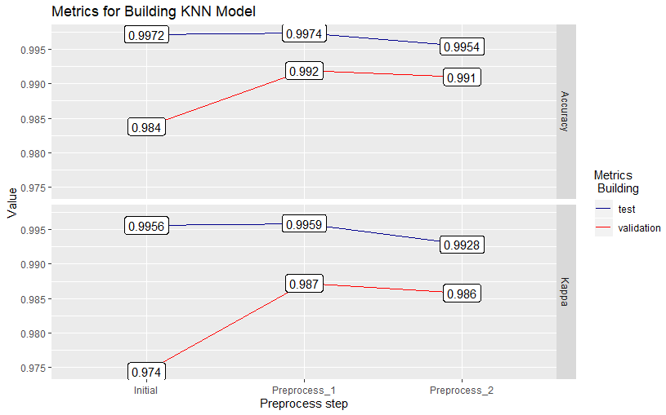
Metrics knn model: Building

Slide 20
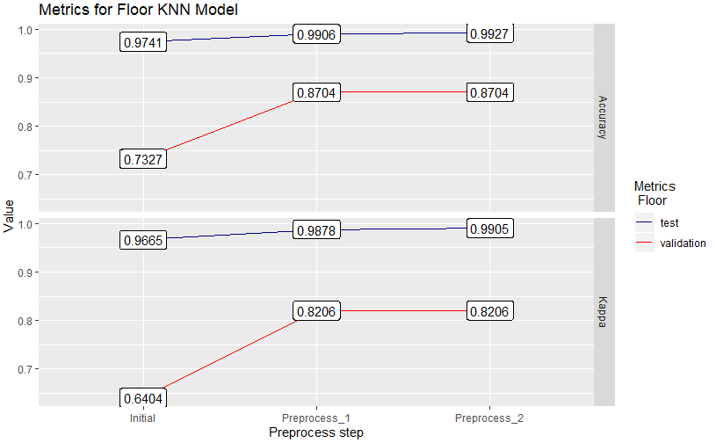
Metrics knn model: floor

Slide 21
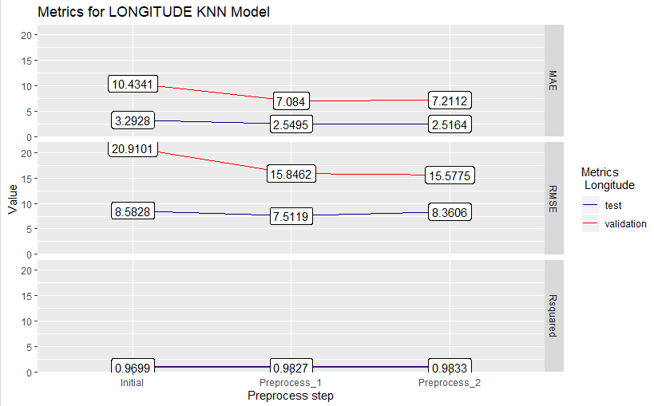
Metrics knn model: Longitude

Slide 22
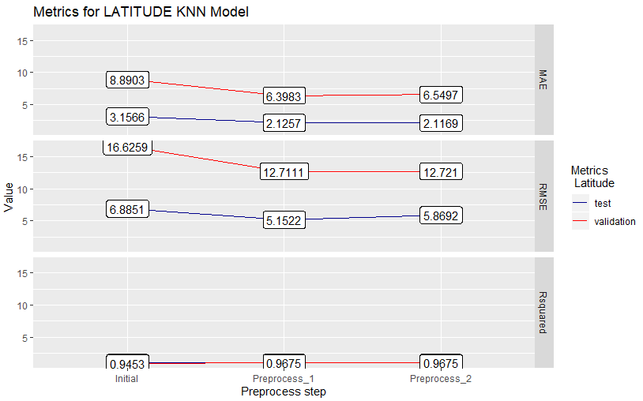
Metrics knn model: latitude

Slide 23
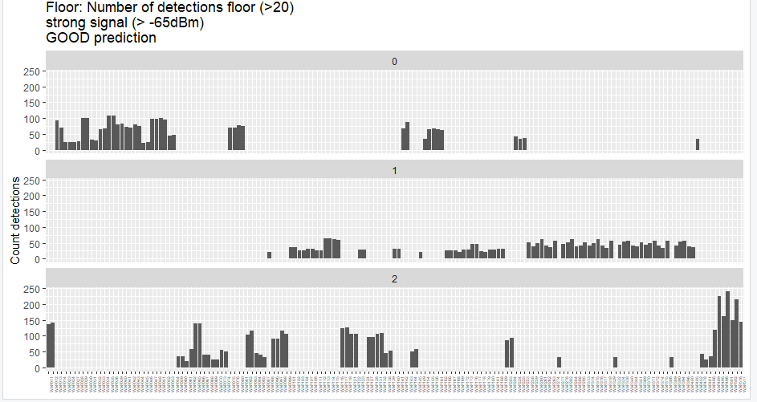
Preprocess step 3 for Floor

Slide 24
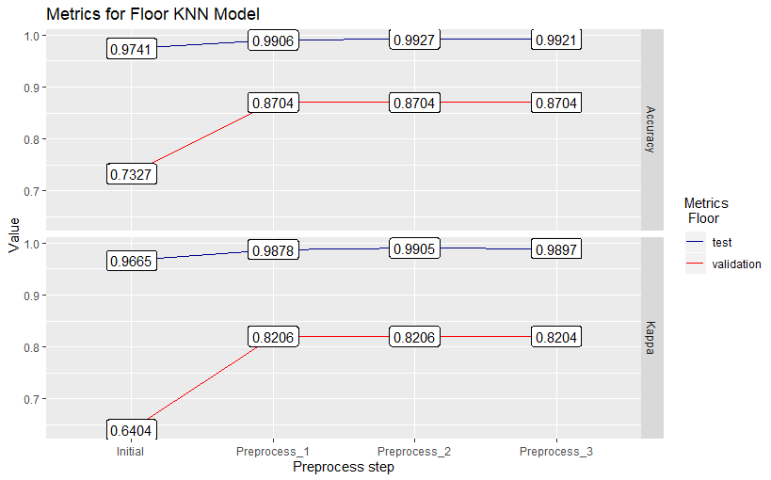
Update Metrics knn model: floor

Slide 25
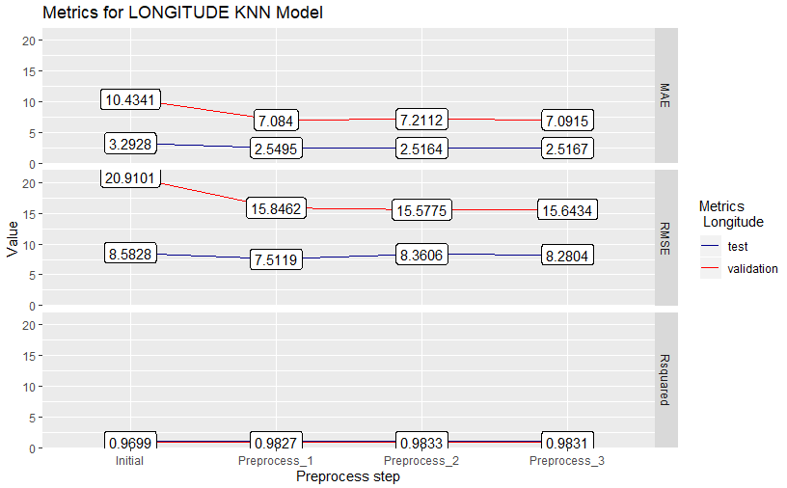
Update Metrics knn model: LONGitude

Slide 26
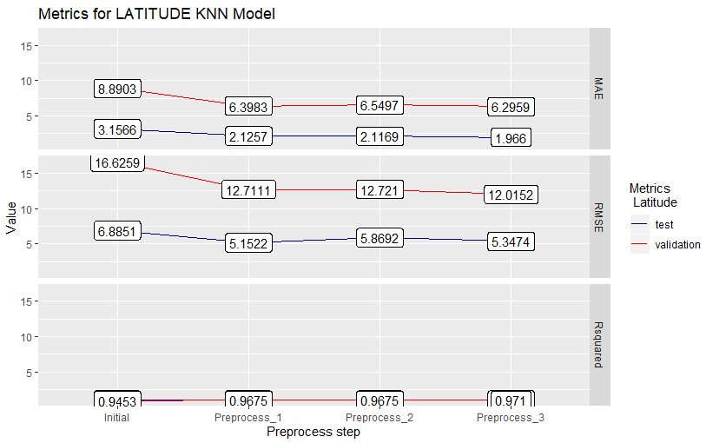
Update Metrics knn model: Latitude

Slide 27
Recommendations;
Model is not sufficiently accurate to implement.
Preprocess the model with exluding values > -30 dBm.
Preprocess the model with excluding duplicate timestamps.

Slide 28

Main points of attention;
How to combine and implement the results?
What are best steps forward when analysing the residuals?
Random Forest was also recommended, but running the model is like…

